Slide 1

Roughness in SLS Eos P500 FDR
Chances in:
build plate position
Build setup
Presence of thin walls

Slide 2
Description of the project
EOS P500 Fine Detail Resolution (FDR)
It works with Ftheta lenses and two 50-watt CO lasers with scan speed of 10 m/sec.
Minimum layer thicknesses of 40/60 µm and minimum wall thicknesses of 0,22 mm
Lasers have beam diameter of 10.6 µm and a spot size of 5 µm
Material used is PA1101 white (glass temperature of 46 ºC and a melting temperature of 180 ºC)
Chamber at 176 ºC, build plate at 175 ºC
Techniques:
Downskin and upskin receive higher energy to keep the part together and make the surface smoother. This cannot be done for contours, where some particles can remain stuck at the border of the melting zone during the offset hatching of the laser and worsen the surface quality. For this reason, the contour is smeared with a second lower laser intensity to flatten all the unwanted stuck particles along the contour.

Slide 3
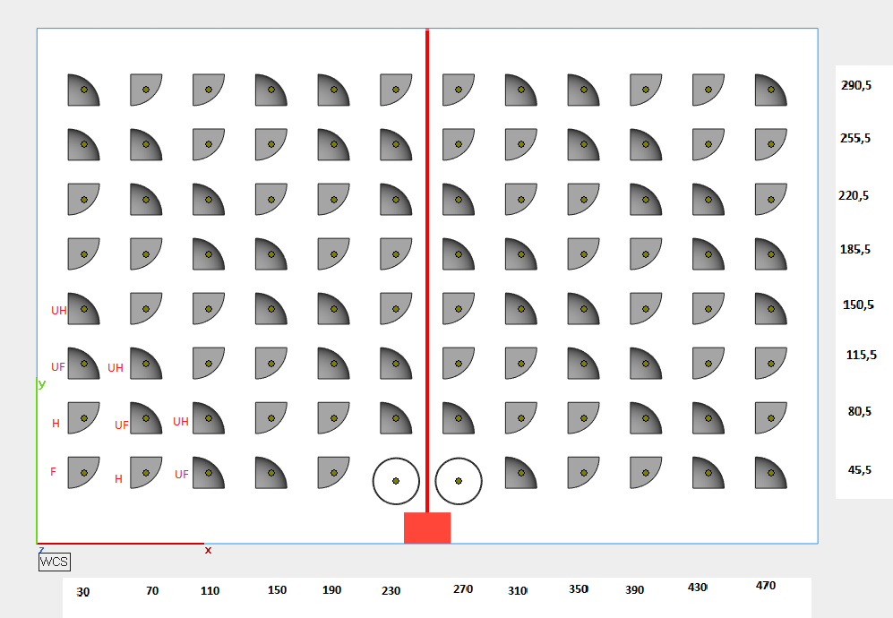
Build plate setting
For each circled sample we carried out:
Image sampling with Olympus LEXT OLS4100
Profile analysis with MountainSpectral® Expert and SPIP 6.7.9
Taguchi Array Design L16(8^1 2^2) with 3 factors and 16 runs
2UH
4F
6H
8UF
10UH
15UF
18UH
20F
21H
23UF
12F
13H
2UF
4UH
6F
8H
10UF
15H
17UF
20UH
22F
23H
12UH
14F
2H
4UF
6UH
8F
10H
16F
17H
19UF
22UH
24F
12UF
14UH
2F
4H
6UF
8UH
10F
16UH
18F
19H
21UF
24UH
11H
13UF
1UH
3F
5H
7UF
9UH
14UF
17UH
19F
20H
22UF
11F
12H
1UF
3UH
5F
7H
9UF
14H
16UF
19UH
21F
22H
11UH
13F
1H
3UF
5UH
7F
9H
15F
16H
18UF
21UH
23F
11UF
13UH
1F
3H
5UF
7UH
9F
15UH
17F
18H
20UF
23UH

Slide 4
Roughness measurements
Roughness has been investigated through Ra, Rq,Sa,Sq for non-contact profilometer:
The image is leveled with LS-plane to find the primay surface and remove waviness following the ISO 25178
3D image is generated and correlated Sa, Sq values are found
Following the ISO 21920 for roughness profiles, 2 filters are applied (Gaussian S-filter and cut-off wavelength at 2.5 µm and Gaussian L-filter and cut-off wavelength at 0.8 mm from ISO 16610-21)
An option manage end-effects has been applied to visualize the full length despite the computed cut-offs
A particle size analysis has been also carried out through the identification of D10, D50, D90, Span for cumulative distribution and broadness:
The detection method is Watershed for Packed Features with classification only related to particles and smallest boundary width of 4 pixels, related to a 2,5 µm x 2,5 µm section
Shallow features are merged with a 5% range threshold

Slide 5
Results (top)

Slide 6
Results (Top)
3UH
4UH
19UH
20UH
5F
6F
21F
22F
9H
10H
12H
13H
11UF
12UF
14UF
15UF

Slide 7
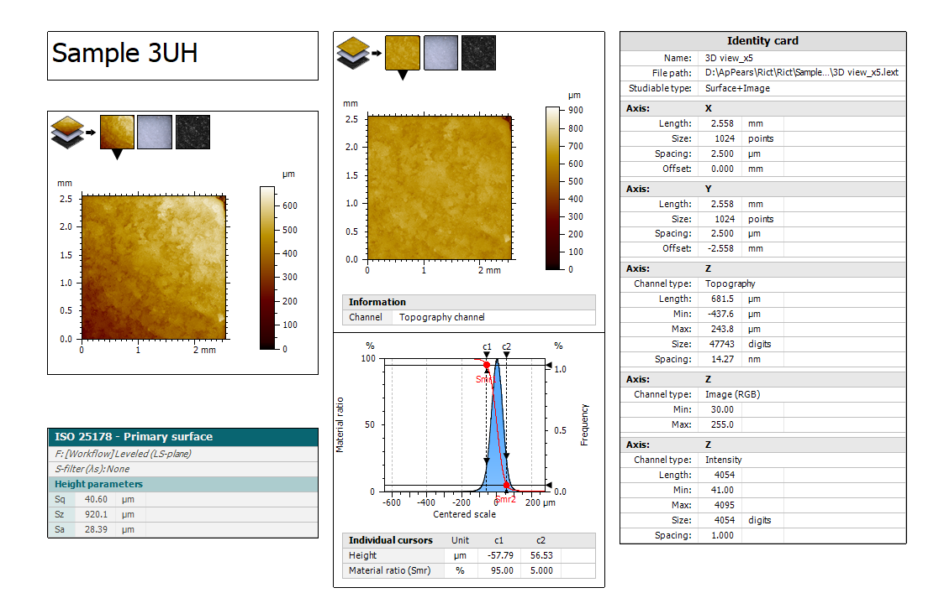
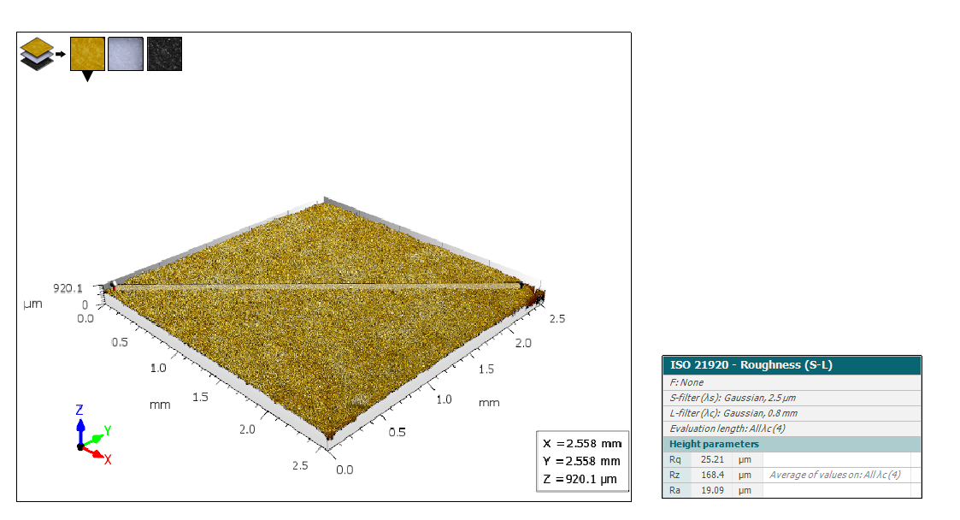
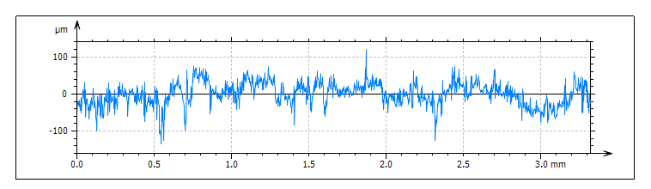

Slide 9
Particle Size analysis (x10)

Slide 10
Particle Size analysis (x10)

Slide 11
Particle Size analysis (x20)

Slide 12
Particle Size analysis (x10)

Slide 13
Results (Side)

Slide 14
Results (Side)

Slide 15
Particle Size analysis (x20)

Slide 16
Particle Size analysis (x20)

Slide 17
Results (Bottom)

Slide 18
Results (BOttom)

Slide 19
Particle Size analysis (x20)

Slide 20
Particle Size analysis (x20)

